Slide 1
Landing Your First Teaching Job: Nailing Your Interview!
Rafael Plascencia
Principal of Marjorie Veeh Elementary
Tustin Unified School District

Slide 2
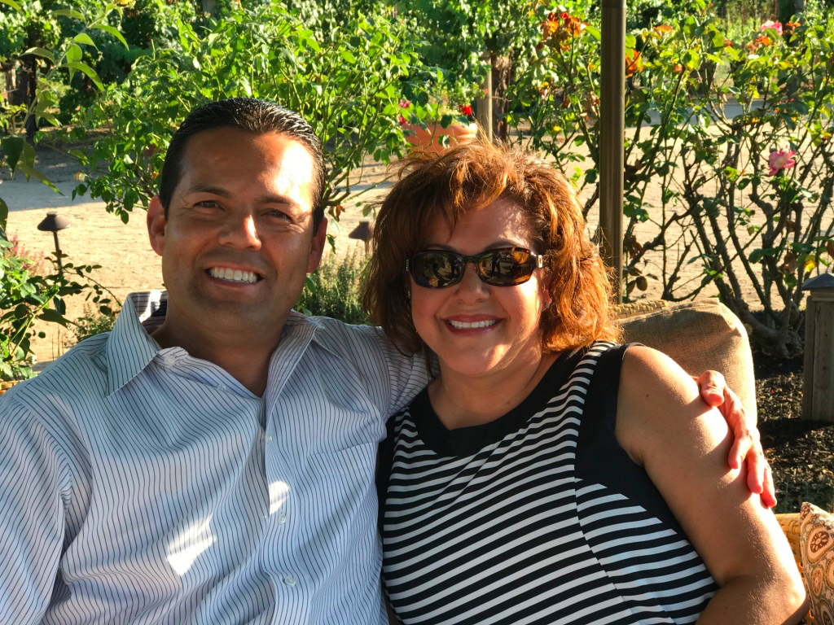

Rafael Plascencia
Principal of Marjorie Veeh Elementary
rplascencia@tustin.k12.ca.us.
@RafaPlascencia6

Slide 3
My Family

Slide 4
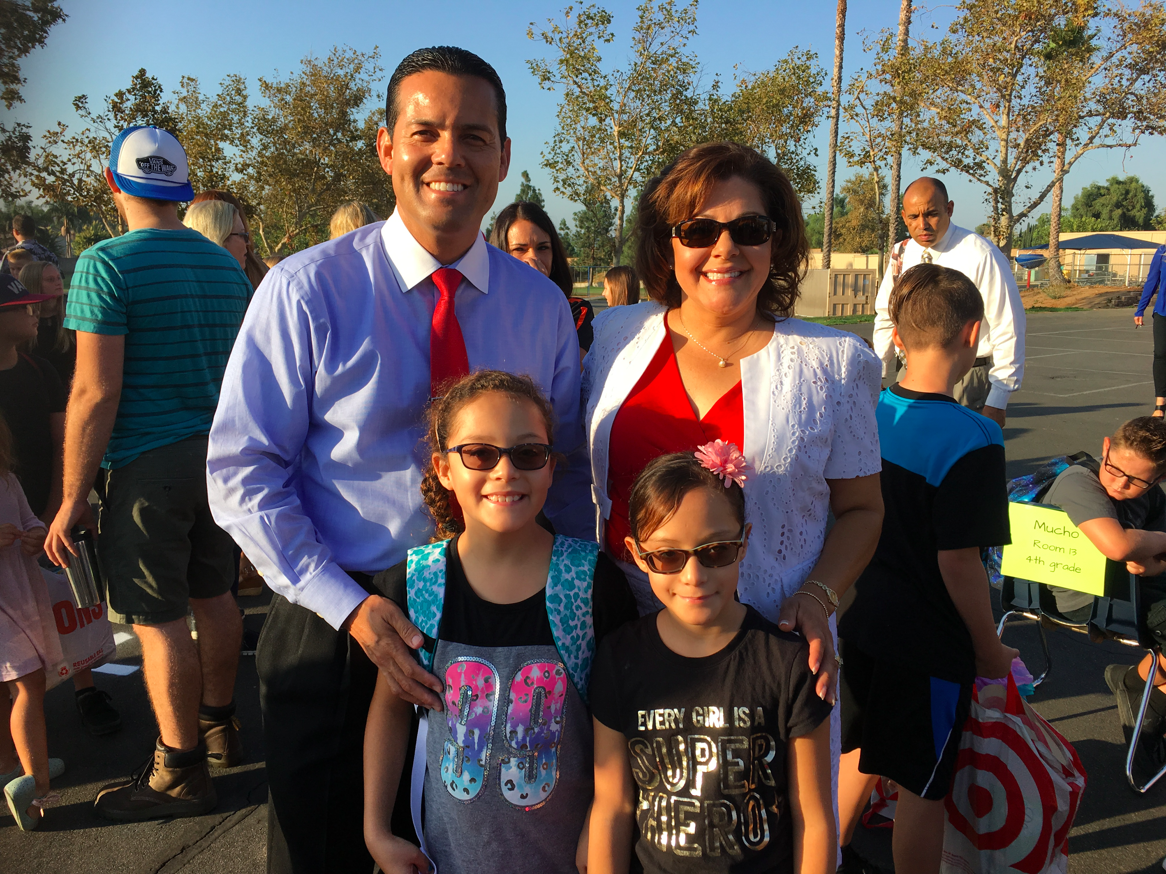

Slide 5
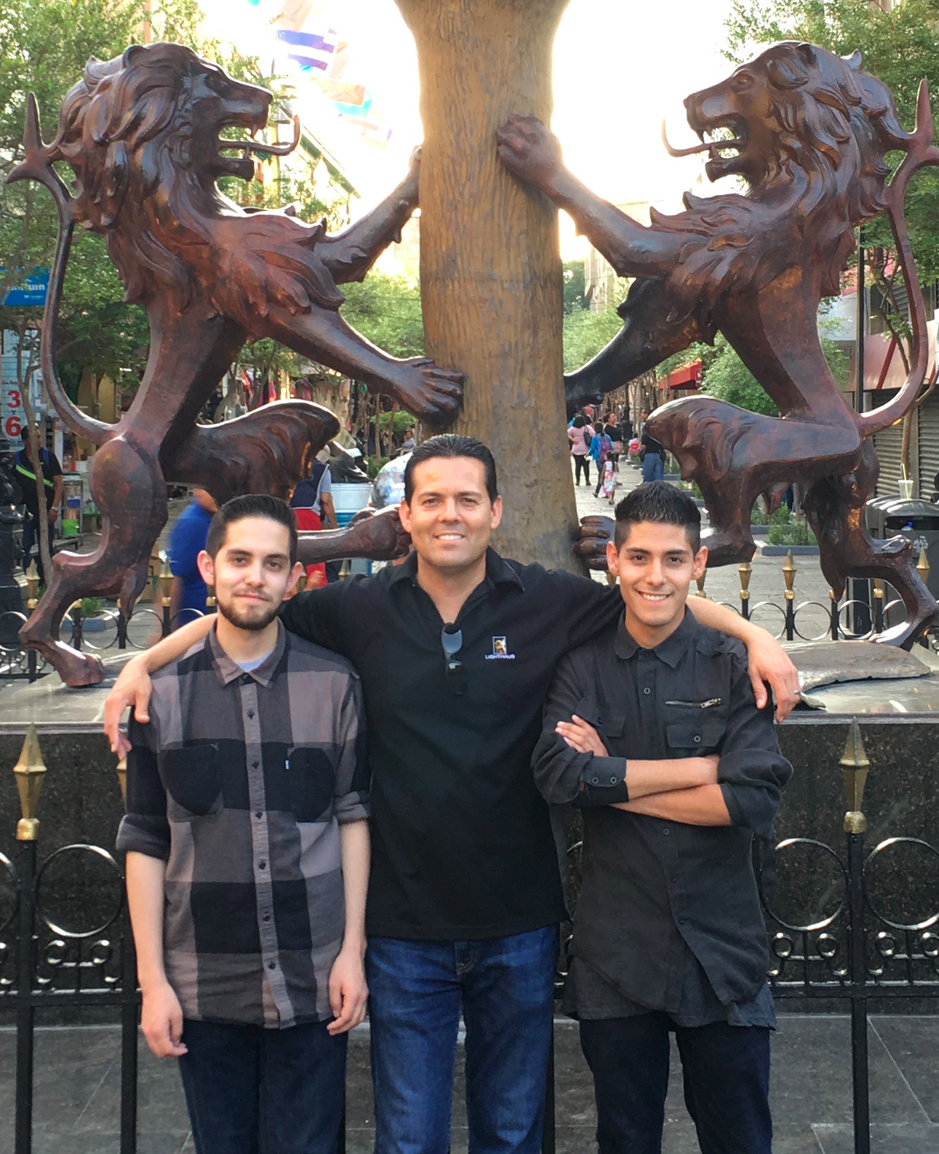

Slide 6
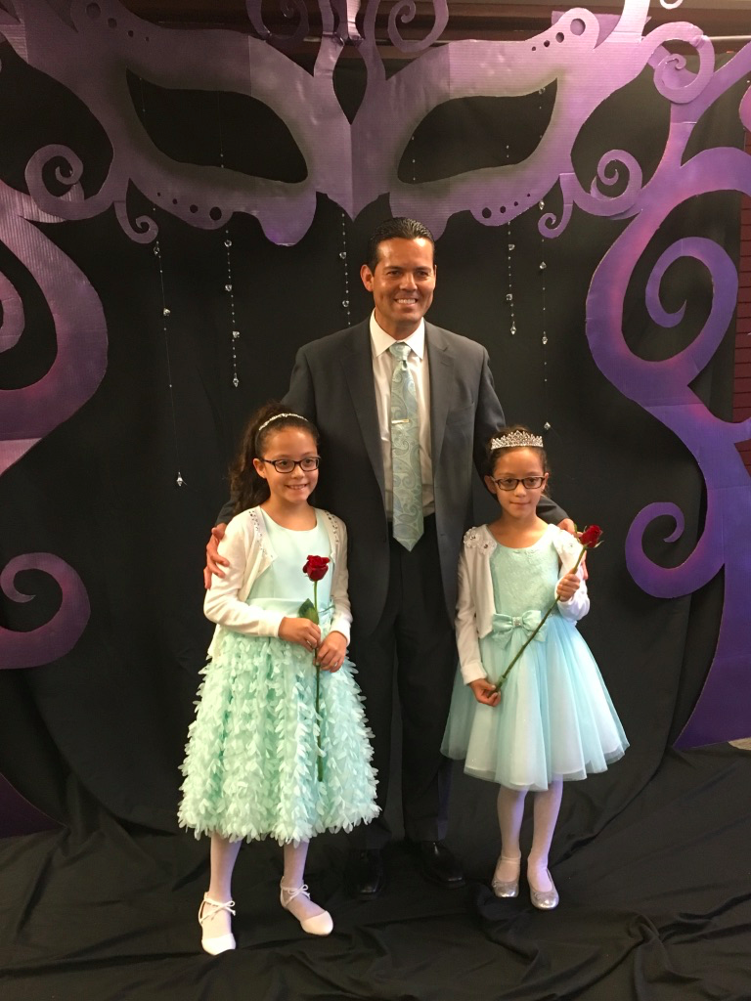

Slide 7
We are going to focus on:
1: The application process
2: Interviews
How do I get my first teaching job?

Slide 8
A Little About Me
  High School Alt Education (Continuation)
  Community Service Liaison (Gang Prevention)
  High School Prev-Intervention (Drop-Prevention)
  Child Welfare & Attendance Supervisor
  Elementary Assistant Principal
  Elementary Principal

Slide 9
A Little About Me
  Schools First FCU Presidential Forum
  CSUF M.S. Educ Adm/PASC Advisory Board
  GOALS Board of Director
  Facilitator - ACSA New & Aspiring Administrators
  Facilitator - ACSA Principals’ Summer Institute
  Past President - ACSA Region 17 (Orange County)
  ACSA State Board of Director

Slide 10
Landing My First Teaching Position
Why do you want to go into teaching?
Know your WHY?

Slide 11

Landing My First Teaching Position
My WHY
What I do is not a career but a calling.
Throughout my life I have worked to improve the lives of children.
I want to create opportunities for all students to become successful in life.

Slide 12
Landing My First Teaching Position
What NOT to do!
I like the working hours of a teacher.
I want a teacher’s salary & benefits.
I want to have summers off.

Slide 13
Successful Teachers:
1. Successful teachers have clear objectives
2. Successful teachers have a sense of purpose
3. Successful teachers are able to live without immediate feedback
4. Successful teachers know when to listen to students and when to ignore them
5. Successful teachers have a positive attitude
6. Successful teachers expect their students to succeed
7. Successful teachers have a sense of humor
8. Successful teachers use praise authentically
9. Successful teachers know how to take risks
10. Successful teachers are consistent
11. Successful teachers are reflective
12. Successful teachers seek out mentors of their own
13. Successful teachers communicate with parents
14. Successful teachers enjoy their work
15. Successful teachers adapt to student needs

Slide 14
Landing My First Teaching Position
Realities of Teaching
  Classroom management
  Planning
  Relationship Building
Your WHY Matters!

Slide 15
Landing My First Teaching Position
First steps in getting hired!
Application Process:
Letter of Introduction
Letter of recommendation
Resume

Slide 16

Landing a Teaching Position
Where to Find a Job and How to Apply
Edjoin.org - finding a job and applying
Teacher Match - screening - personality tests and risk assessment

Slide 17
Landing My First Teaching Position
Strong Resume
Interactions with children - Coaching, mentoring, youth group, camp counseling
Educational Experiences - tutoring, volunteering in classrooms, substituting (take everything, do what you are told)
Educational Background -
  Priority 1: courses taken that relate to education
  Priority 2: courses in your subject area
  Priority 3: academic achievement

Slide 18
Landing My First Teaching Position
Strong Letter of Introduction
Talk about your why.
Have a specific examples about teaching.
Talk about experience
Be Positive and enthusiastic

Slide 19
Landing My First Teaching Position
Strong Letters of Recommendation
In professional education - teachers and administrators
In education related fields - coaching, camp, tutoring

Slide 20
Nailing Your Interview!
What are some things to keep in mind in an interview?
BE ON TIME - arrive 10-15 minutes early.
Have a copy of your resume
Have a professional but relaxed attitude.
  Act like you want the job.
  Shake everyone’s hands

Slide 21
Nailing Your Interview!
Dress Appropriately
Hair - combed/brushed and neat
Women
  professional blouse
  Skirt or slacks - no jeans
  Coat - if you want
  dress or casual shoes - no athletic shoes
Dress Appropriately
Hair - combed/brushed and neat
Men
  Shirt
  Tie
  Slacks - no jeans
  Coat - if you want but it looks professional
  Dress or casual shoes - no athletic shoes

Slide 22

Nailing Your Interview!
Interview questions
Focus on classroom management
  Have a plan
  Know PBIS
  Positive Proactive Strategies
  Contact with parents
  Do not say you would send students to the office

Slide 23
Nailing Your Interview!
Interview Questions
Focus on Pedagogy
  Classroom management
  (PBIS Safe and Civil Schools)
  Interactive Strategies
  Reading and Writing
  Common Core Standards - NGSS
  Technology

Slide 24

Nailing Your Interview!
Interview Questions
Technology
  Get a gmail account and be familiar with Google Docs
  Get an iPad or Chromebook/Laptop
  Know how to use a device beyond word processing and slideshows

Slide 25
Nailing Your Interview!
Interview Questions
Experiences
  Positive Experiences
  Specific Examples
  Be confident

Slide 26

Nailing Your Interview!
After the Interview
  A thank you note or email is a great touch.
  Follow up phone call or email if you do not hear within a week.

Slide 27
Nailing Your Interview!
Practice Interview Anyone?
Questions?
Thank you!

